Slide 1
Digital Portfolio
STUDENT NAME : S Sanjith
REGISTER NO AND NMID : asnum161222402516
DEPARTMENT : BSc.Computer science
COLLEGE: COLLEGE/ UNIVERSITY : Prince Shri Venkateswara Arts & Science college

Slide 2
PROJECT TITLE :
Digital Portfolio

Slide 3


AGENDA
Problem Statement
Project Overview
End Users
Tools and Technologies
Portfolio design and Layout
Features and Functionality
Results and Screenshots
Conclusion
9. GitHub link
3/21/2024 Annual Review

Slide 4

PROBLEM STATEMENT
Resumes and profiles often feel static and fail to show creativity or real skills. A digital portfolio provides an engaging way to present projects, talents, and achievements more effectively. Showcase skills clearly and provide a simple way for visitors to get in touch.

Slide 5

PROJECT OVERVIEW
This digital portfolio is designed to showcase my skills, projects, and achievements in a modern and interactive way. It contains containers for my skills,about me and contact information. The goal is to create a single platform where employers, clients, and collaborators can easily explore my work and understand my capabilities.

Slide 6

WHO ARE THE END USERS?
Potential Employers/Recruiters – to evaluate skills, projects, and experience.
Clients/Collaborators – to explore work samples before partnerships.
Peers/Community – for networking, learning, and inspiration.

Slide 7

TOOLS AND TECHNIQUES
Vs code - Code Editor
HTML – Structure purpose
CSS – Styling purpose
Javascript – Interactive purpose
Github – Hosting Platform

Slide 8
PORTFOLIO DESIGN AND LAYOUT
Layouts Included:
Header/nav
footer
Form fields
Skills section
Visual rationale
8

Slide 9
FEATURES AND FUNCTIONALITY
First, the page showcases my skills in two categories—Programming Languages and Tools—using clean, pill-shaped tags that make the stack easy to scan at a glance. These tags are static list items for display, not inputs. Next, there’s a contact section with a simple form: name, email, and message, plus a send button. The inputs are semantic and use the right types, so the browser understands what each field is for. The form includes built-in validation: required fields must be filled, and the email field must look like a real email before submission. The browser shows native error messages if something’s missing or invalid

Slide 10
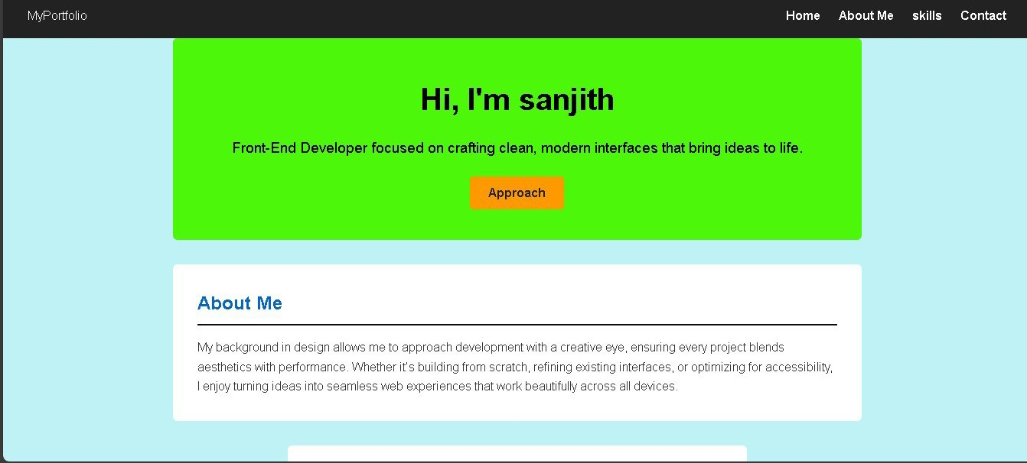

RESULTS AND SCREENSHOTS
3/21/2024 Annual Review
10

Slide 11
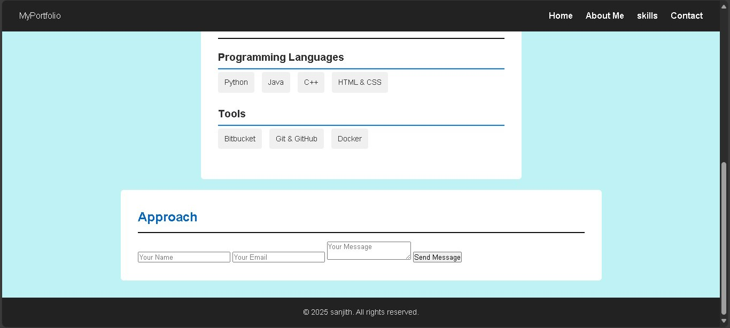

Slide 12
CONCLUSION
A digital portfolio is more than just a resume — it’s a creative way to showcase who I am, what I can do, and the work I’m proud of. It helps me stand out, connect with opportunities, and grow in today’s digital world.
12

Slide 13
GitHub link 🔗
https://13346cs2024-cell.github.io/TNSDC-FWD-DP/

